Slide 1

2GA3 Tutorial #5
DATE: October 22nd, 2021
TA: Jatin Chowdhary

Slide 2
T01
I gotta kick you out by 10:20AM
  But only this time
Someone’s feedback was: ‘‘more energy’’
  Can do!
    It’s time to double down

Slide 3
T02
We didn’t have enough time for feedback last class
  But we’re doing it right now!
Grab a sheet, something to write with, and fill it out
  Once you finish, toss it in the binder
    And then get whatever snack you want

Slide 4
Changes
Going forward, tutorials will be structured in the following manner:
  5 MINS
    General stuff (i.e. Administrative)
  5 MINS
    Review (i.e. Multiple choice questions)
  20 MINS
    Easy questions
  20 MINS
    Hard questions

Slide 5
Administrative Stuff (1)
How was the midterm?
  Easy, medium, hard, etc.
  MSAF?
  Are there any questions I should review?
‘‘Is there a solution manual?’’
  I’ll try to find one
Will take assignment questions now
  Fair warning: I’ll be useless
Get out of your comfort zone
  I’ve got 5 weeks to work on you
    Why? (I’ll explain later)

Slide 6

Administrative Stuff (2)
Be mindful of what you eat or put in your mouth

Slide 7
Review Question #1
Question: Can we use a base-1 (unary) number system to represent all the numbers? Assume that special tricks are not used.
Options:
  A) Yes we can
  B) No we cannot
  C) Depends on the number
  D) Only in CalcCheck
  E) None of the above

Slide 8
Explanation For #1
Explanation: In a base-1 number system, we only have 1 number to work with. For example:
  1⁰ + 1¹ + 1² + 1³ + … + 1^{n}
    We can represent all the natural numbers, except for 0
      A ‘‘trick’’ is needed to represent negative numbers
        Expect compromises
  2⁰ + 2¹ + 2² + 2³ + … + 2^{n}
    Same as above
Note: We can have a voltage difference in a unary number system, as long as the base-number isn’t 0. And with a few tricks, we can use a unary number system in a computer
  i.e. The following wouldn’t work: 0⁰ + 0¹ + 0² + 0³ + … +0^{n}
    This stuff is beyond the content of 2GA3; so don’t worry about it
      But it is good to know

Slide 9
Review Question #2
Question: Find the typo: addi x10, x10, x4
Options:
  A) addi
  B) x10
  C) x4
  D) The commas
  E) The instruction needs to be capitalized
  F) None of the above

Slide 10
Review Question #3
Question: What does blt stand for
Options:
  A) Bacon, Lettuce, Tomatoes
  B) Branch Less Than
  C) BaselLand Transport
  D) Bounded Linear Transformation
  E) None of the above
  F) All of the above

Slide 11
Review Question #4
Question: Fill in the blanks: RISC-V stands for _____, and is _____ endian
Options:
  A) Reduced instructions on system and computer && Little
  B) Reduced instruction set compiler && Big
  C) Reduced instruction set compiler && Little
  D) Reduced instruction set computer && Big
  E) Reduced instruction set computer && Little
  F) None of the above

Slide 12
Review Question #5
Question: Which of the following correspond to floating point instructions?
Options:
  A) flw
  B) fld
  C) fsw
  D) fsd
  E) fadd.s
  F) fmul.d
  G) feq.s
  H) All of the above
  I) None of the above

Slide 13
Review Question #5
Question: Why do we have immediate instructions?
  Asked By Esha
Answer: Because it’s quicker
  Loading from memory is expensive (time consuming)
    i.e. It’s easier to bake a cake if all of the ingredients are in the pantry. But if you have to go to the store, then it’s going to slow you down a lot
    i.e. Pen demo

Slide 14
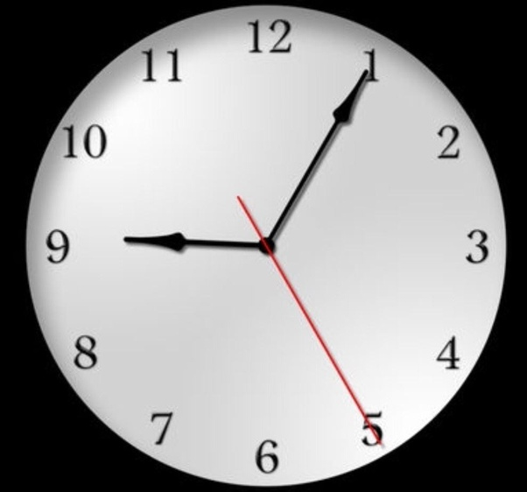
Clockwork Arithmetic
Clockwork arithmetic
  Also known as modular arithmetic
    This is where the mod function comes from (i.e. 9 mod 2 = 1)
Refer to the picture:
  1:00PM + 2 HRs = ? PM
    No *flow
  7:00PM – 5 HRs = ? PM
    No *flow
  9:00PM + 6 HRs = ? ? ?
    Overflow or underflow?
  6:00AM – 12 HRs = ???
    Overflow or underflow?

Slide 15
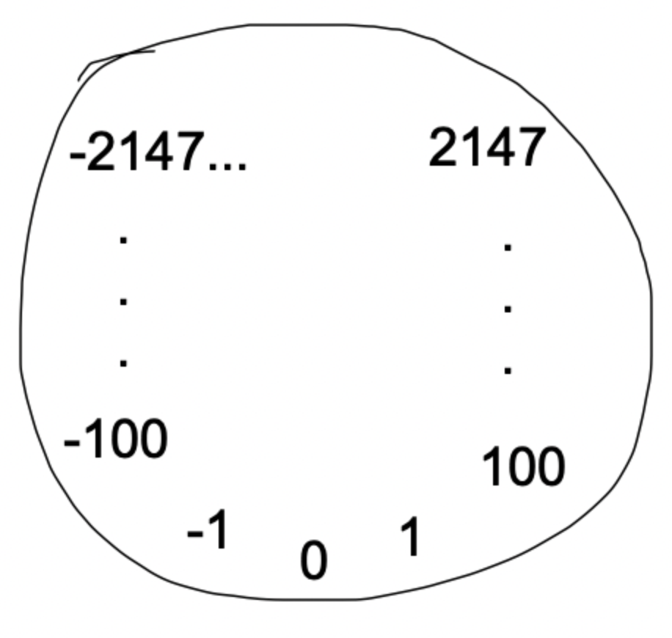
Overflow In C
‘‘Talk is cheap, show me the code’’ – Linus T.
  i.e. *flow.c
Summary:
  If the value is too big, then overflow
  If the value is too small, then underflow

Slide 16
Tutorial Question #1
Question: Assume (185)10 and (122)10 are unsigned 8-bit decimal integers. Calculate 185 ‒ 122. Is there underflow, overflow, or neither?
Precursor:
  185 and 122 are decimal integers
    They are 8-bits
      This is the size
    Unsigned
      What does this mean?

Slide 17
Answer For Question #1
1. 8 bit signed means that:
  The maximum value is:
    2⁸ – 1 = 255
  The minimum value is:
    0
2. Convert (185)10 and (122)10 to binary
  See #3
3. The conversion is:
  (185)10 = (1011 1001)2
  (122)10 = (0111 1010)2
4. Subtract the result
  1011 1001 – 0111 1010
  = (0011 1111)2
  = (63)10
5. 63 is within [0, 255]
  Hence, there is no overflow

Slide 18
Tutorial Question #2
Question: Assume (185)10 and (122)10 are signed 8-bit decimal integers stored in sign-magnitude format. Calculate (185 + 122). Is there overflow, underflow, or neither?
Precursor:
  What is signed?
    How does this affect the 8-bit size?
      What is the range? (Min/Max)
  What is sign-magnitude format?
    The most significant digit (MSD) determines if the number ispositive/negative
      MSD = Leftmost digit

Slide 19
Answer For Question #2
(122)10 = (0111 1010)2
  The first bit is 0, so this is a positive number
    So the value doesn’t change
(185)10 = (1011 1001)2
  The first bit is 1, so this is a negative number
    So the number is (0011 1001)2 = 57
      But, because of the sign bit, it is negative
        (1011 1001)2 = –57
          MSD IS FOR THE SIGN (IN A SIGNED NUMBER)
Calculation
  Next slide

Slide 20
Answer For Question #2
The equation is: ‒57 + 122
  Answer: 65
    In binary: (0111 1010)2 – (0011 1001)2 = (0100 0001)2
    122 57 65
But wait!
  What’s the range (min/max) of a signed 8-bit number in signed-magnitude format?
    Answer: [-127, 127]
      Does 65 fall into this range? Yes
        Hence, there is overflow/underflow/neither

Slide 21
Review Question #7
Question: In an unsigned number, the MSD represents the signage; whether it is positive or negative?
Options:
  True
  False
  I’m Hungry

Slide 22
Review Question #8
Question: In signed-magnitude format, how many ways can 0 be represented?
Options:
  1
  2
  3
  4
  0
  ∞
  None of the above

Slide 23
2 Ways?!?
We know that (0)10 is (0000 0000)2
But, recall that the most significant bit is ONLY for signage.
  Since the MSD doesn’t affect the numeric value, other than signage, we can add a 1:
    (1000 0000)2
      And this is still 0

Slide 24
Tutorial Question #3
Question: Assume 185 and 122 are signed 8-bit decimal integers stored in sign-magnitude format. Calculate 185 −122. Is there overflow, underflow, or neither?
Answer: (Same logic as question #2)
  The numbers are:
    (185)10 = (1011 1001)2 = (–57)10
    (122)10 = (0111 1010)2 = (122)10
  Calculate: (185 – 122) → (–57) – (122)
    –57 – 122 = –179
  Overflow/underflow/neither?
    Next slide

Slide 25
Answer For Question #3
What’s the range for a signed 8-bit decimal in signed-magnitude format?
  (It’s the same as the previous question)
    It is: [‒127, 127]
The answer we got is: –179
  Does –179 fall into [‒127, 127]
Is there overflow, underflow, neither?
  Answer: Overflow

Slide 26
Saturation Arithmetic (1)
All operations are limited to a fixed range
  In other words, you cannot go above the maximum value, or below the minimum value
    If you reach the maximum value, you stay at the maximum value
    If you reach the minimum value, you stay at the minimum value
For example, assume we are working with an 8-bit unsigned integer
  Max value = 255
  Min value = 0
You don’t wrap around like Clockwork arithmetic

Slide 27
Saturation Arithmetic (2)
For example, assume we are working with an 8-bit signed integer in signed-magnitude format
  Max value = 127
  Min value = ‒127
You don’t wrap around like Clockwork arithmetic
  Instead, you stay at the min/max

Slide 28
Two’s Complement (1)
What is it?
  A way of storing integers so that common math problems are simple to implement
Rules:
  Zero
    Represented by all 0’s
  Positive Integers
    Start counting as you normally would
  Negative Integers
    Do the same thing as above, but then flip the bits
      0 → 1
      1 → 0

Slide 29
Two’s Complement (2)
Positive numbers:
  (0000)2 = (0)10
  (0001)2 = (1)10
  (0010)2 = (2)10
  (0011)2 = (3)10
Negative numbers:
  (1111)2 = (‒1)10
  (1110)2 = (‒2)10
  (1101)2 = (‒3)10
  (1100)2 = (‒4)10

Slide 30
Two’s Complement (3)
Negative numbers:
  (1111)2 = (‒1)10
    Another way to think about this:
      ‒8 + 4 + 2 + 1 = ‒1
  (1110)2 = (‒2)10
    ‒8 + 4 + 2 = ‒2
  (1101)2 = (‒3)10
  (1100)2 = (‒4)10

Slide 31
Tutorial Question #4
Question: Assume 151 and 214 are signed 8-bit integers stored in two’s complement. Calculate 151 + 214 using saturating arithmetic.
The result should be written in decimal.
Answer:
  (151)10 = (1001 0111)2
    (1001 0111)2 → ‒128 + 16 + 4 + 2 + 1 = ‒105
  (214)10 = (1101 0110)2
    (1101 0110)2 → ‒128 + 64 + 16 + 4 + 2 = ‒42
  ‒105 + (‒42) = ‒147
    But wait! We are using saturation arithmetic
      So what do we do? Next slide

Slide 32
Answer For Question #4
Answer:
  What is the range of values in a signed 8-bit number stored in two’s complement?
    Answer: [‒128, 127]
  The result from the previous slide is ‒147
    Since we cannot go past ‒128, the answer is ‒128
      This is saturation arithmetic; we cannot go higher than the max, or lower than the min

Slide 33
Hold On… -127 VS. -128
Recall that:
  In signed-magnitude format, the range of possible values is [‒127, 127]
  In two’s complement, the range of possible values is [‒128, 127]
Why?
  Because in signed-magnitude format, there are 2 ways of representing 0
    This problem doesn’t exist in two’s complement

Slide 34
Tutorial Question #5
Question: Assume 151 and 214 are signed 8-bit decimal integers stored in two’s complement format. Calculate (151 − 214) using saturating arithmetic.
The result should be written in decimal.
Answer: (Same logic as question #4)
  Convert to binary:
    (151)10 = (1001 0111)2
    (214)10 = (1101 0110)2
  Apply two’s complement:
    Next slide

Slide 35
Answer For Question #5
Answer:
  Apply two’s complement:
    (1001 0111)2 → ‒128 + 16 + 4 + 2 + 1 = (‒105)10
    (1101 0110)2 → ‒128 + 64 + 16 + 4 + 2 = (‒42)10
  Calculate:
    (‒105) ‒ (‒42) = ‒105 + 42 = (‒63)10

Slide 36
Tutorial Question #6
Question: Assume 151 and 214 are unsigned 8-bit integers. Calculate 151 + 214 using saturating arithmetic. The result should be written in decimal.
Homework!
  Very simple
    Hint: There is saturation/overflow!
    Hint: Pay attention to the format of the number
      See tutorial question #1

Slide 37
What Is All This?
What is the point of clockwork/modular arithmetic? Saturation arithmetic?
  A way for the computer to do math
What is 1’s complement? 2’s complement? Sign-magnitude format?
  A way for the computer to represent numbers

Slide 38
Quick Note
Always pay attention to the format of the number
  Is it in two’s complement? Signed-magnitude? One’s complement?
    This makes a big difference!
      Also, is it signed/unsigned?

Slide 39
Tutorial Question #7
Question: Calculate the time necessary to perform a multiply using the approach given in Figure below if an integer is 8 bits wide and each step of the operation takes four time units. Assume that in step 1a an addition is always performed—either the multiplicand will be added, or a zero will be. Also assume that the registers have already been initialized (you are just counting how long it takes to do the multiplication loop itself). If this is being done in hardware, the shifts of the multiplicand and multiplier can be done simultaneously. If this is being done in software, they will have to be done one after the other. Solve for each case.
  Figure on next slide

Slide 40
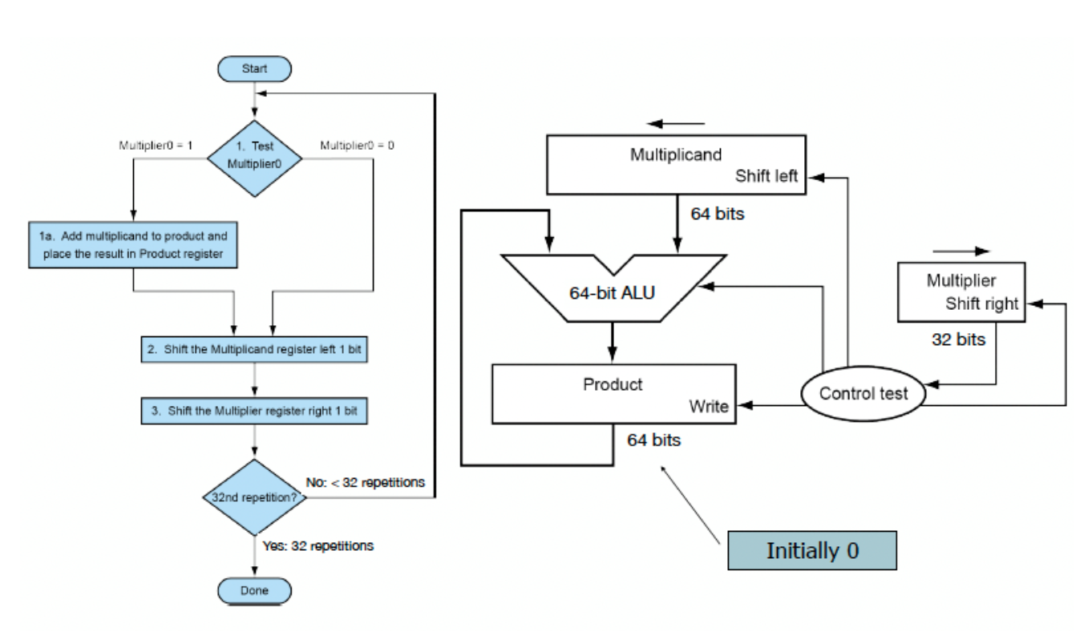
Figure For Question #7

Slide 41
Answer For Question #7
Precursor:
  General
    Integer is 8-bits
    Each step takes 4 time units
    ‘‘Assume that in step 1a an addition is always performed’’
    ‘‘Assume that the registers have already been initialized’’
  Hardware:
    ‘‘If this is being done in hardware, the shifts of the multiplicand and multiplier can be done simultaneously’’
  Software:
    ‘‘If this is being done in software, they will have to be done one after the other’’

Slide 42
Answer For Question #7
Answer:
  Hardware:
    1 cycle for addition
    1 cycle for both shifts
    1 cycle to check if we are done
    1 + 1 + 1 = 3 cycles in total
  Software:
    1 cycle to decide what to add (i.e. 1 vs. 0)
    1 cycle for addition
    1 cycle to shift the multiplicand register
    1 cycle to shift the multiplier register
    1 cycle to check if we are done
    1 + 1 + 1 + 1 + 1 = 5 cycles in total

Slide 43
Answer For Question #7
* Instructions Carried Out By Hardware (Per Cycle)
* Instructions Done By Software (Per Cycle)

Slide 44
Answer For Question #7
Answer:
  Since the integer is 8 bits wide, each bit has to go through the loop, and each step of the operation takes 4 time units
    Hardware:
      3 cycles x 8 bits x 4 time units = 96 time units
    Software:
      5 cycles x 8 bits x 4 time units = 160 time units

Slide 45
Hardware VS. Software
Why is this important?
  The main idea is that:
    Things implemented in software can also be done in hardware
    Things implemented in hardware yield better performance (more efficient) than software
      However, not everything is possible to do in hardware
      Making changes to hardware is virtually impossible
        Reflashing is possible but tedious
    Things implemented in software can be easily changed, but it is less ‘‘reliable’’

Slide 46
Tutorial Question #8
Question: Calculate the time necessary to perform a multiply using the approach given in Figure below if an integer is 8 bits wide and an adder takes four time units.
Answer: (Homework)
  Hints:
    Remember that the integer is 8 bits wide
    Each adder takes 4 time units
    An adder handles 2 bits
    Determine how many levels of adders are required
      Remember that adders on the same level execute simultaneously
        This is key!

Slide 47
Tutorial Answer #8
Question: Calculate the time necessary to perform a multiply using the approach given in Figure below if an integer is 8 bits wide and an adder takes four time units.
Answer: (Hidden)
  The adders are arranged in an inverted tree structure. After every level, the number of adders is cut in half
    Since we have 8 bits, we need to use 4 adders in the first level, 2 adders in the second level, and 1 adder in the last level. In total, we need to use 7 adders.
      Since each adder, rather each level takes 4 time units, and we only go through 3 levels, the time it takes is: 3 levels x 4 time units = 12 time units

Slide 48
Tutorial Answer #8
Question: Calculate the time necessary to perform a multiply using the approach given in Figure below if an integer is 8 bits wide and an adder takes four time units.
Answer: (Hidden)
  Another way to compute the number of levels is:
  log2(A), whwere A is the number of adders
    So log2(8) = 3
      Therefore, 3 levels

Slide 49
THE END

